Slide 1

MEGATHON'26 · Fusion for Future
24-Hour Hackathon · Saveetha Engineering College (Autonomous)
Voice-First, Stage-Adaptive
AI Companion for
Dementia Patients
🧠
PS 2 · Adaptive Care Policy Engine · India-Ready Privacy-First Solution
57M+
$1.3T
0/7
3
People with
Dementia (WHO)
Global Economic
Cost (2019)
Competitors with Full
Policy Engine
Core Unsolved
Problems
Final Solution Submission — MEGATHON'26
Domain: Healthcare AI & Social Impact · Problem Statement: PS 2
Saveetha Engineering College (Autonomous)
1 / 8

Slide 2
MEGATHON'26 | Fusion for Future
1. Team & Problem Overview
MEGATHON'26 · Final Submission · Saveetha Engineering College
TEAM INFORMATION
TEAM MEMBERS & ROLES
Team Name:
👤
[Member 1 Name]
[YOUR TEAM NAME]
Team Lead / AI & Backend Developer
Team ID:
[YOUR TEAM ID]
[Member 2 Name]
👤
Problem Statement:
Frontend Developer / UX Designer
PS 2 — Voice-First, Stage-Adaptive AI Companion for Dementia Patients
Domain / Category:
[Member 3 Name]
Healthcare AI & Social Impact
👤
ML Engineer / Distress Detection
GitHub Repository:
[github.com/your-repo]
👤
[Member 4 Name]
Demo Link:
Data Engineer / Memory Architecture
[your-demo-link.com]
2 / 8

Slide 3
MEGATHON'26 | Fusion for Future
2. Problem Understanding & Proposed Solution
Why generic AI fails — and what we build instead
⚠ THE PROBLEM
✅ OUR SOLUTION: ADAPTIVE CARE POLICY ENGINE
🔢
57 Million People
🎯
Stage-Adaptive Policy
Living with dementia globally (WHO, 2026) — 60%+ in low/middle-income countries.
Caregiver configures Early/Mid/Late-stage profile. AI adjusts sentence length, pacing, question-type per stage — dynamically.
💰
$1.3 Trillion Cost
🔄
Repetition Intelligence
Annual global economic burden. ~50% from informal caregivers bearing enormous stress.
Detects repeated-question loops. Selects reassure / validate / redirect strategy while maintaining emotional consistency across 20+ repeats.
🔁
Repetition & Distress
🛡
Delusion-Safe Guardrail
Patients ask the same question 20–40× daily. Generic AI gives new answers each time — causing confusion.
"I can see this frightens you. I am here with you." — validates emotion, never confirms harmful false beliefs. Follows NIA & Alz. Society guidance.
🌙
Sundowning (6–9 PM)
⚠
Distress Risk Scoring
Agitation spikes at dusk. AI must detect and respond — not continue chatting normally.
Green / Amber / Red model using time-of-day, voice prosody, sentiment & repetition count. Triggers caregiver alert automatically.
🧩
Hallucinations & Delusions
📚
Auditable Family Memory
AI must never confirm false beliefs. Validating emotion without reinforcing delusion is clinically critical.
Verified Personal Memory Architecture — every fact has source, confidence & approval. LLM cannot invent biography.
🛡
No Stage Adaptation
🤝
Human-in-the-Loop
All 7 competitors lack a full stage-adaptive interaction policy with delusion-safe guardrails.
High-risk state triggers caregiver alert with reason + transcript snippet. AI de-escalates; human takes over.
3 / 8

Slide 4
MEGATHON'26 | Fusion for Future
3. Solution Architecture & Technology Stack
Patient
Voice Input
Speech-to-Text
(Whisper / STT)
Intent +
Repetition Detector
Emotion / Prosody
Analyser
Distress Risk
Scorer 🟢🟡🔴
▶
▶
▶
▶
▼
▼
⚙ ADAPTIVE CARE POLICY ENGINE (Core Innovation)
🚨 Caregiver
Alert & Handoff
Stage Profile · Repetition Strategy · Delusion-Safe Guardrail · Distress Routing · Memory Verification
▼
Personal Memory
Architecture
(Verified Biography)
LLM Generator
(Constrained Prompt
+ Stage + Facts)
Text-to-Speech
(Slow, Clear Voice
Adjustable Rate)
Patient
Response
(Voice Output)
▶
▶
▶
↑ Memory Retrieval (Vector Search + Metadata Filters)
TECHNOLOGY STACK
AI / ML
Backend
Frontend
Privacy & Infra
Whisper STT · Sentence Transformers
Small Text Classifier (Repetition)
OpenAI / Anthropic API (LLM)
Prosody Feature Extraction
Python / FastAPI
Vector DB (Pinecone / Weaviate)
Postgres (Memory + Consent Logs)
Redis (Session State)
React Native (Patient Voice UI)
React Web (Caregiver Dashboard)
Push Notifications (Expo)
QR / Demo Link
DPDP Act 2023 Compliant
Role-Based Access Control
Audit Log (Memory Changes)
AWS / GCP Cloud + On-device TTS
4 / 8

Slide 5
MEGATHON'26 | Fusion for Future
4. Prototype Development & Implementation
Working modules, demo scenarios & challenges overcome
🎙 Voice Input Pipeline
🔄 Repetition Detector
⚙ Policy Engine
Whisper STT → transcript + confidence score. Fallback confirmation prompts on low confidence. Tested with accented Tamil-English speech.
Sentence-embedding similarity + counter. Flags repeated-question loops within a session. Triggers strategy switch after threshold.
Deterministic state machine. 6 response modes: Reassure, Validate, Orient, Reminisce, Redirect, Escalate. Stage-locked communication rules.
📚 Memory Architecture
⚠ Distress Scorer
📱 Caregiver Dashboard
Family uploads verified facts (name, relationship, music, events). Vector search retrieves top-k facts. No LLM biography invention.
Green/Amber/Red model. Combines: repeat-count, text sentiment, hour-of-day, session length. Red → instant caregiver push alert.
Real-time alerts with reason + transcript snippet. Memory management (add/edit/delete facts). Role-based access (family vs professional carer).
CHALLENGES FACED & SOLUTIONS
🎤 STT accuracy on elderly speech → Whisper large-v3 + confidence threshold + re-prompt fallback
🔁 Detecting repetition vs. genuine new question → Embedding cosine similarity + 0.85 threshold tuning
🛡 LLM refusing guardrails → System-level policy injection + output validation layer before TTS
🔒 DPDP consent in prototype → Consent record table + "why stored" labels on every memory fact
5 / 8

Slide 6
MEGATHON'26 | Fusion for Future
5. GitHub, Testing & Validation
Code quality, test coverage & evaluation metrics
📁 GITHUB REPOSITORY
🧪 TESTING & EVALUATION METRICS
Repository Link:
Repetition Consistency
[github.com/your-team/dementia-companion]
20× same scenario — emotional & factual consistency measured. Target: <5% inappropriate variation.
Repository Structure:
Biography Factuality
/backend — FastAPI + Policy Engine
% responses using only approved facts. Target: 100% verified-fact-only responses in pilot.
/frontend — React Native (Patient UI)
Safety Accuracy (Red-team)
/dashboard — React Web (Caregiver)
Rate of delusion-confirming outputs under adversarial probing. Target: 0% harmful confirmations.
/ml — Repetition + Distress Models
/memory — Vector DB + Consent Schema
Distress Detection
Sensitivity / Precision on labelled pilot set. Green/Amber/Red threshold calibration.
/tests — Unit + Integration + Redteam
/docs — Architecture + API Reference
Escalation Latency
README.md — Setup + Demo Instructions
Time from risk threshold crossing to caregiver push alert. Target: <5 seconds.
Team Contributions (Commit History):
Accessibility Score
[View commit history with per-member breakdown on GitHub]
Avg utterance length ≤12 words (Early stage). Speaking rate calibration. User correction rate.
Documentation: Inline docstrings + API reference + Memory Schema README
Caregiver Usefulness
Reduction in manual reassurance interventions during 30-minute pilot session.
Code Quality: Linted (Ruff) · Type-annotated · GitHub Actions CI
6 / 8

Slide 7
MEGATHON'26 | Fusion for Future
6. Impact, Future Scope & Team Contribution
🌍 IMPACT & SCALABILITY
🚀 FUTURE ENHANCEMENTS
💡 SOCIAL & INDUSTRY
57M
People who could benefit globally
🏥 Clinician read-only view — longitudinal behaviour export to GP/neurologist
UN SDG 3
Good Health & Well-being for elderly population
60%+
In low/middle income countries — India-first design
📷 Vision-based emotion — facial expression analysis supplements voice signals
Caregiver Relief
50%
Caregiver burden reduction potential
🎵 Personalised music therapy — curated playlists from patient era/genre preference
Reduces emotional & time burden on family caregivers
India-First
Multilingual
Tamil, Hindi, English support in roadmap
🌐 Multilingual expansion — Tamil, Hindi, Malayalam voice models fine-tuned on elderly speech
Anvayaa-style India context + DPDP compliance built-in
📟 Wearable integration — smartwatch heart rate + movement as additional distress signals
Healthcare AI
DPDP-ready
India DPDP Act 2023 compliant architecture
Clinically-grounded, not a generic chatbot wrapper
🔬 Longitudinal AI staging — recommend stage review to caregiver over time (no auto-diagnosis)
Open API
Integrates with hospital / senior care EMR systems
B2B / B2C
🏠 Smart-home linking — routine reminders triggered by ambient sensor context
Senior care homes, hospitals, families, NGOs as channels
TEAM MEMBER CONTRIBUTIONS
[Member 1] — Project Lead: Policy Engine design, system architecture, LLM prompt engineering, integration
[Member 2] — Frontend: React Native patient UI, caregiver dashboard React web, UX flow, accessibility design
[Member 3] — ML: Repetition detector, distress risk scorer, prosody feature extraction, model evaluation
[Member 4] — Backend + Data: FastAPI, vector DB schema, memory architecture, DPDP consent system, DevOps
Thank You · Demo Link: [your-demo-link] · GitHub: [github.com/your-repo] · Saveetha Engineering College
7 / 8

Slide 8
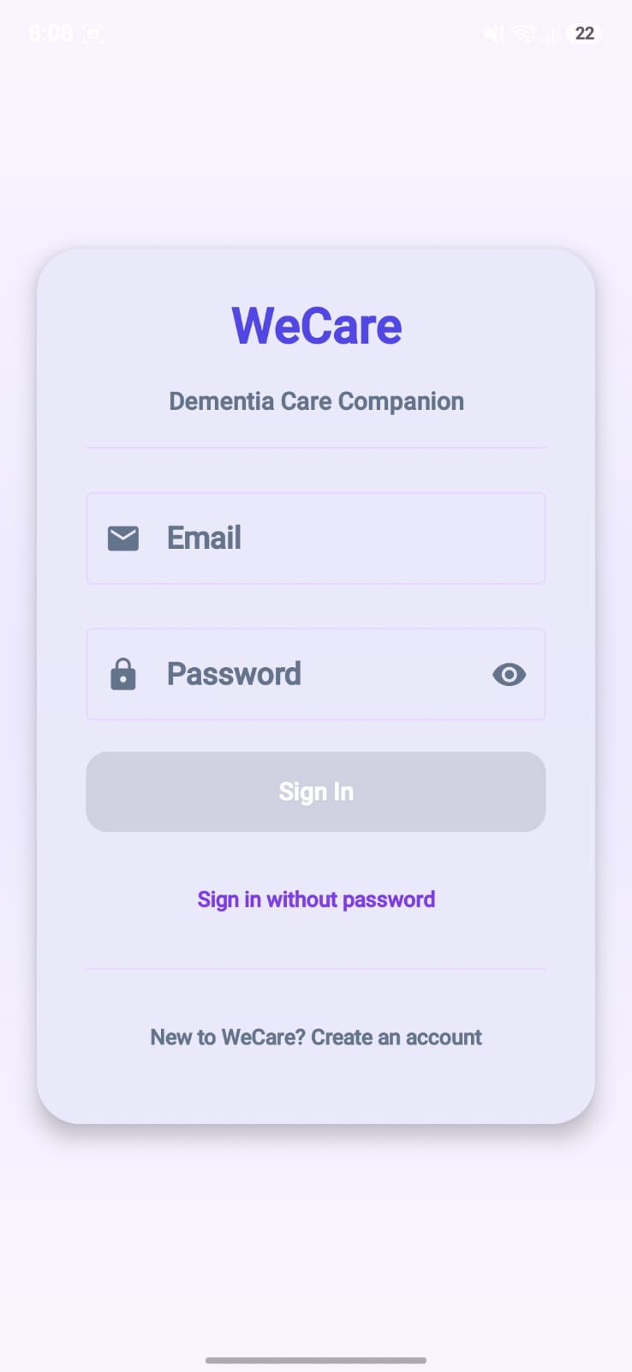
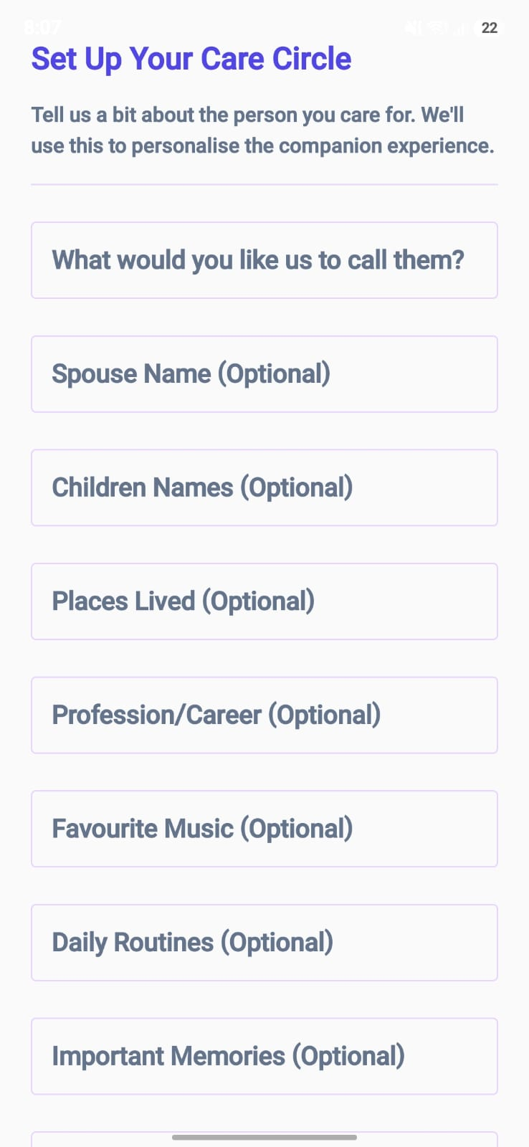
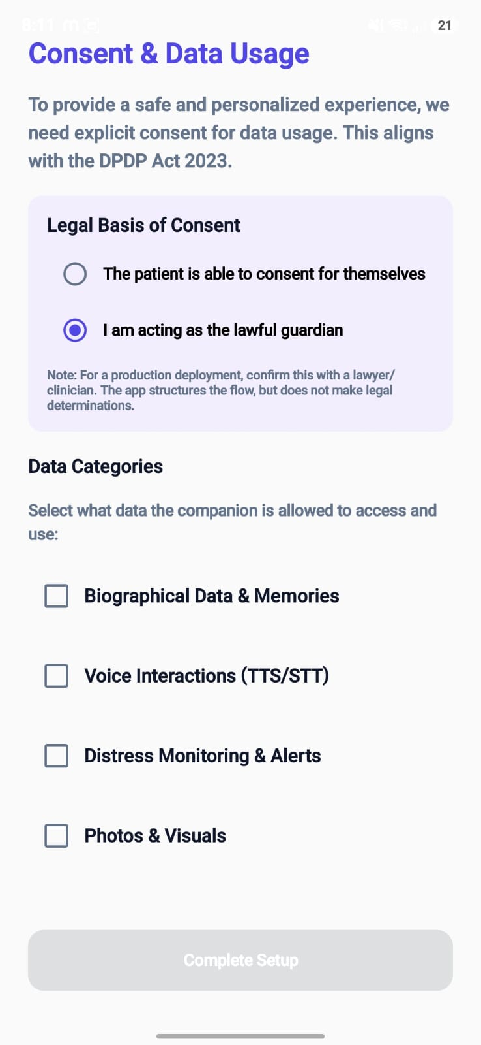
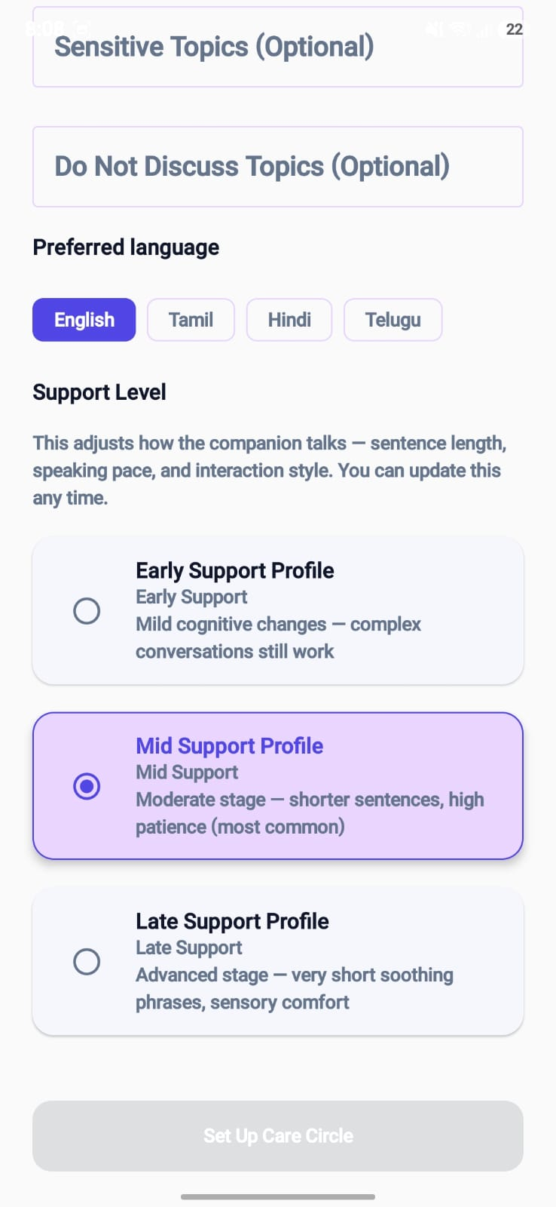
MEGATHON'26 | Fusion for Future
7. Demo Screenshots & Live Demo
🔗 LIVE DEMO: [your-demo-link]
📱 APP WALKTHROUGH — LIVE SCREENSHOTS
Guardian Sign-In
Care Circle Setup
DPDP-Aligned Consent
Support-Level Tuning
Thank You · Demo Link: [your-demo-link] · GitHub: [github.com/your-repo] · Saveetha Engineering College
8 / 8

